Slide 1
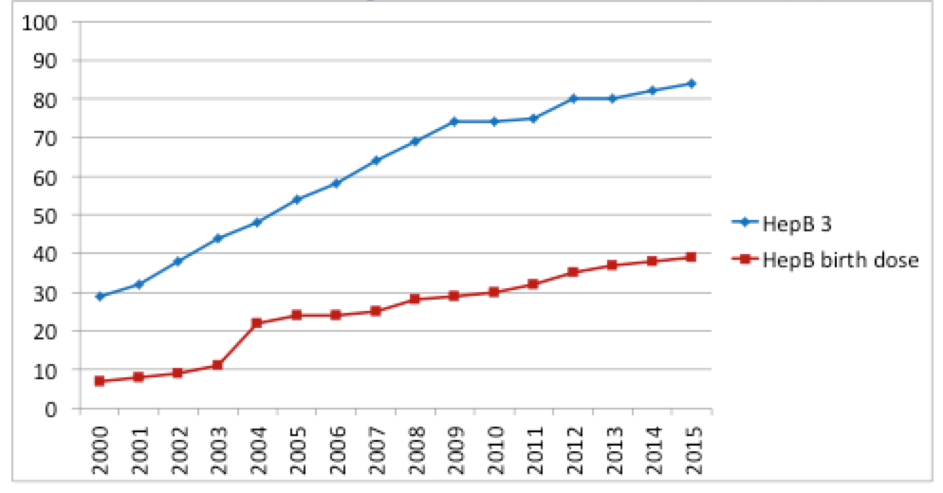
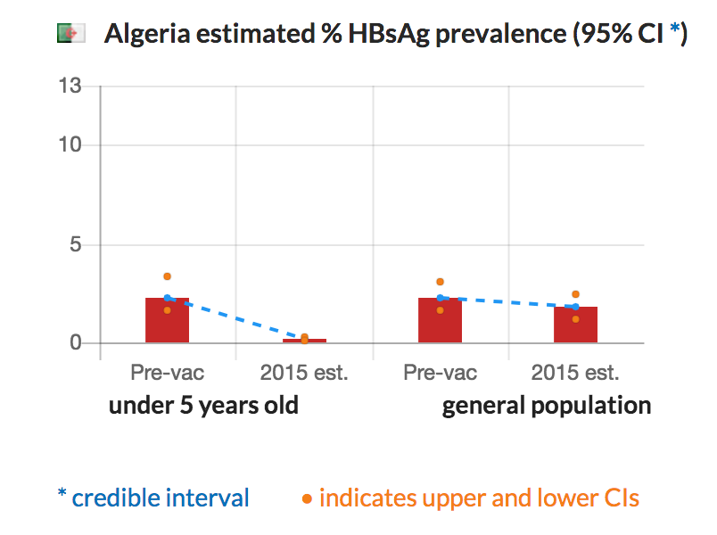
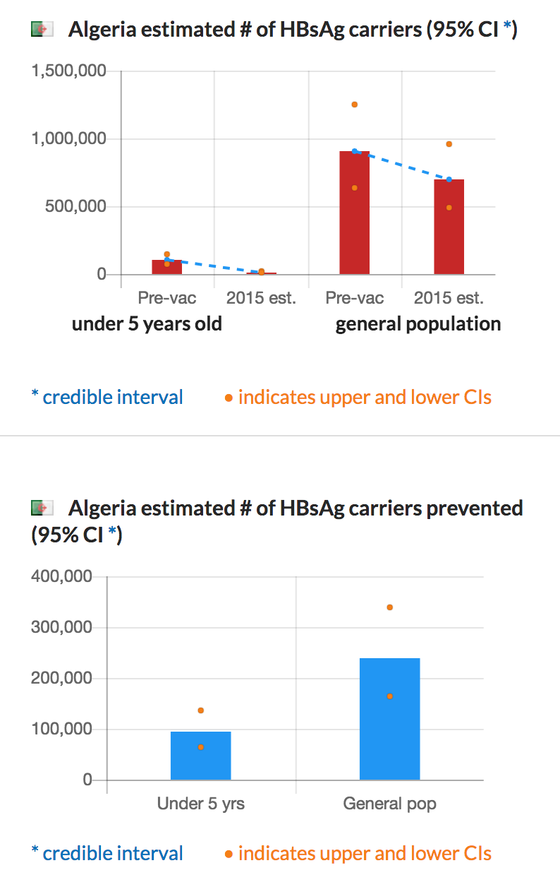
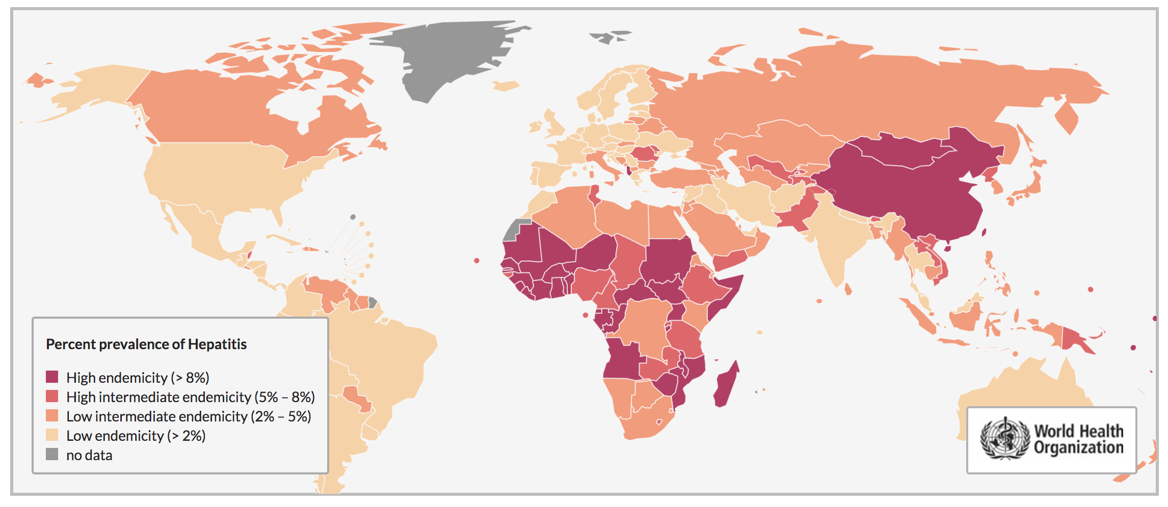
FrontPage
Strategy
Burden of Disease
Vaccine
Systematic Review & Model
Global Immunization 3rd dose of Hepatitis B (HepB3) coverage in infants and Birth Dose of Hepatitis B in newborns, 2000-2015
STATUS OF HEPATITIS B: FIRST FIVE YEARS OF LIFE – A CRITICAL TIME TO PREVENT CHRONIC HEPATITIS B INFECTION
01_Introtext.doc
World
World
World

Slide 2
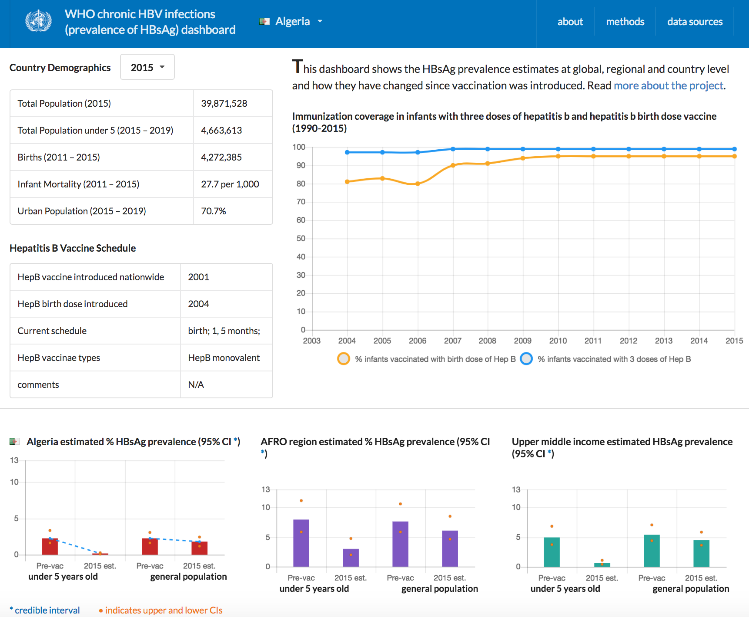
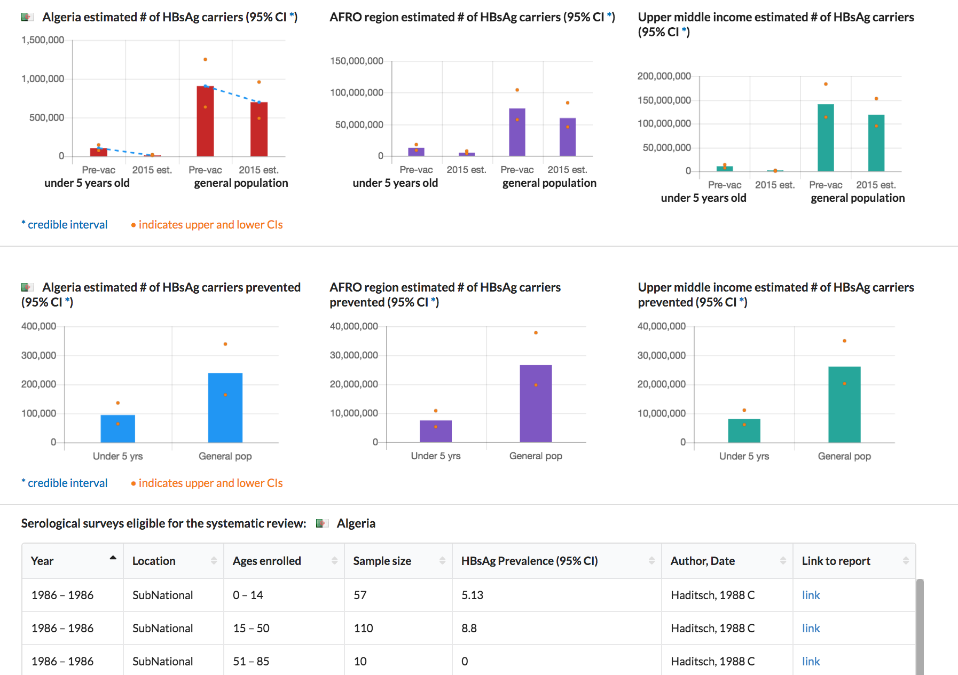
Burden of Disease Page
02_BODtext.doc

Slide 3
Strategy Page
03_Strategytext.doc

Slide 4
Systematic Review & Model Page
04_Methodstext.doc

Slide 5
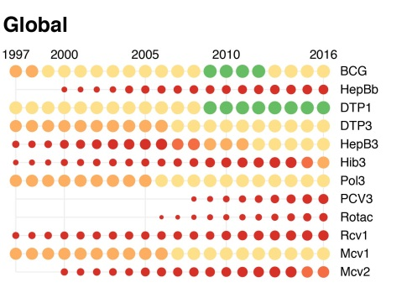
Vaccine Page
05_Vaccinetext.doc

